Slide 1
X-Ray Crystallography Laue Method
By Elijah Gill

Slide 2
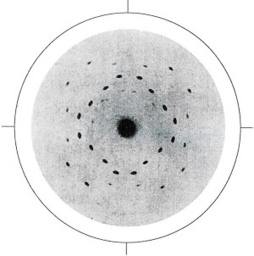
History of X-Ray Crystallography
1895 - Wilhelm Conrad Röntgen discovers X-rays
It was unknown whether X-rays were waves or particles
1912 – Max von Laue shone X-rays through crystals
The X-rays were diffracted, proving they were waves.
But the diffraction pattern created depended on the crystal used.
William and Lawrence Bragg then used this technique to prove the periodicity of atomic structure.
X-ray diffraction of ZnS done by Max Laue
National Institute of Health. 120 Years Since The Discovery of X-Rays. [Internet]. 2016 [cited 2024 Mar 18]. Available from: https://pubmed.ncbi.nlm.nih.gov/29693857/
Institute of Physics. Crystallography. [Internet]. 2024 [cited 2024 Mar 18]. Available from: https://www.iop.org/explore-physics/big-ideas-physics/crystallography
Image: Thomas, J. The birth of X-ray crystallography. Nature 491, 186–187. [Internet]. 2012 [cited 2024 Mar 18]. Available from: https://doi.org/10.1038/491186a
Notes:
Some of the X-rays will be reflected off the planes in the crystal, however most of them will pass straight through. These X-rays, if detected, would cause a bright spot in the centre of the image taken and make it more difficult to see the diffraction pattern. So, a ‘beam blocker’ is placed between the crystal and the detector, which absorbs all the incoming X-rays from the direct beam of light.

Slide 3

Theory
Diffraction spots can be explained with Bragg’s Law: nλ = 2dsin(θ)
Bragg Angle can be calculated using the Miller Indices: $sinθ=\frac{h}{\sqrt{h^{2}+k^{2}+l^{2}}}$
Distance between planes: $d=\frac{a}{\sqrt{h^{2}+k^{2}+l^{2}}}$
Minimum wavelength: $λ_{min}=\frac{hc}{eV}$ (3.542 x10⁻¹¹ m for this experiment)
Bragg Angle can also be calculated experimentally: $θ=0.5 arctan\left(\frac{L}{D}\right)$
θ
θ
θ
θ
d
L
D
θ
Thomas, J. The birth of X-ray crystallography. Nature 491, 186–187. [Internet]. 2012 [cited 2024 Mar 18]. Available from: https://doi.org/10.1038/491186a

Slide 4
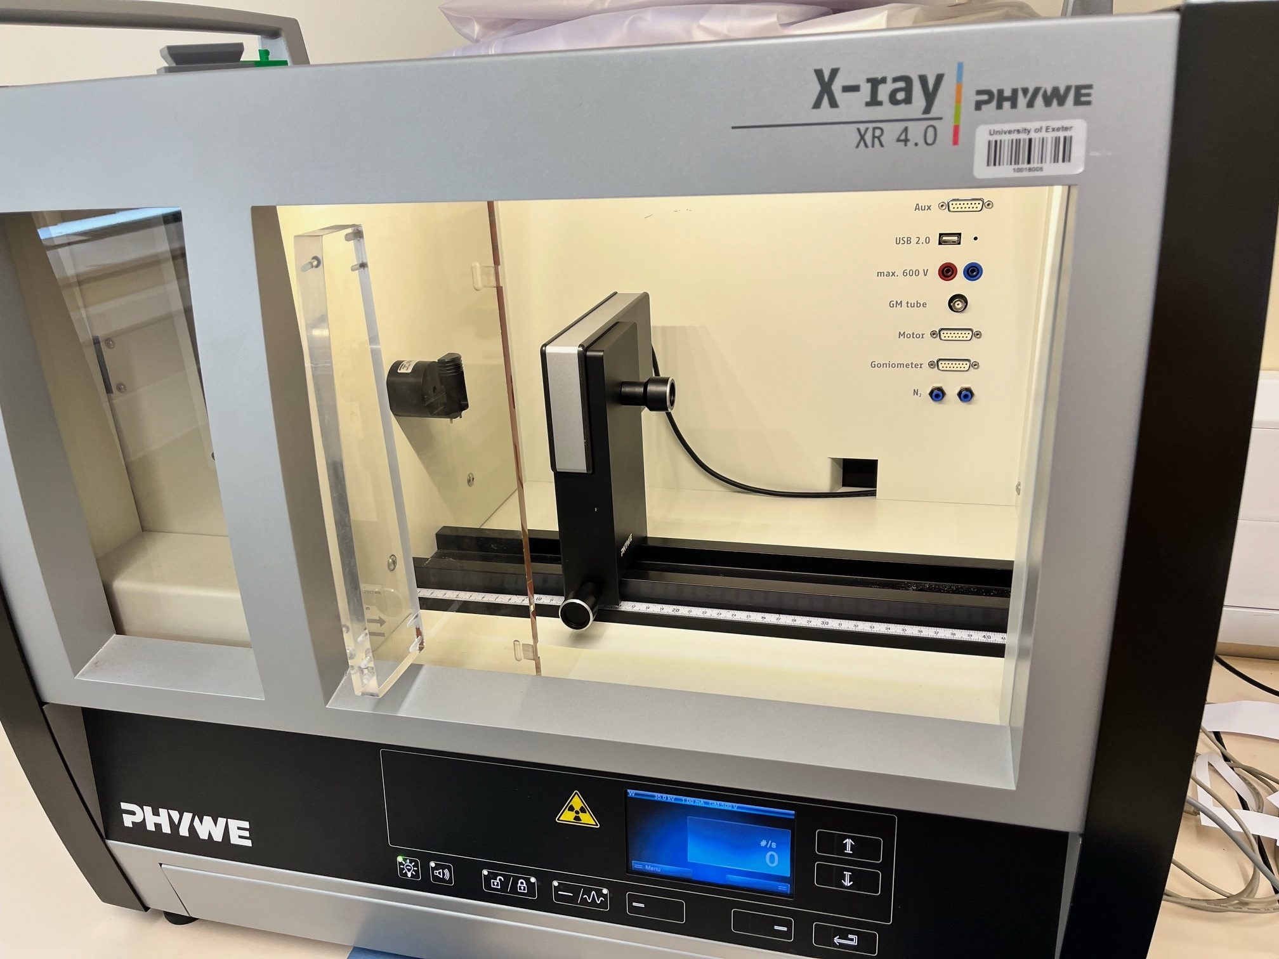
Experiment Setup
Crystal
1mm Aperture
Beam Blocker
X-rays
Detector
Crystal
X-ray Tube
1mm Aperture
X-ray Imaging Sensor (XRIS)
Notes:
Some of the X-rays will be reflected off the planes in the crystal, however most of them will pass straight through. These X-rays, if detected, would cause a bright spot in the centre of the image taken and make it more difficult to see the diffraction pattern. So, a ‘beam blocker’ is placed between the crystal and the detector, which absorbs all the incoming X-rays from the direct beam of light.

Slide 5
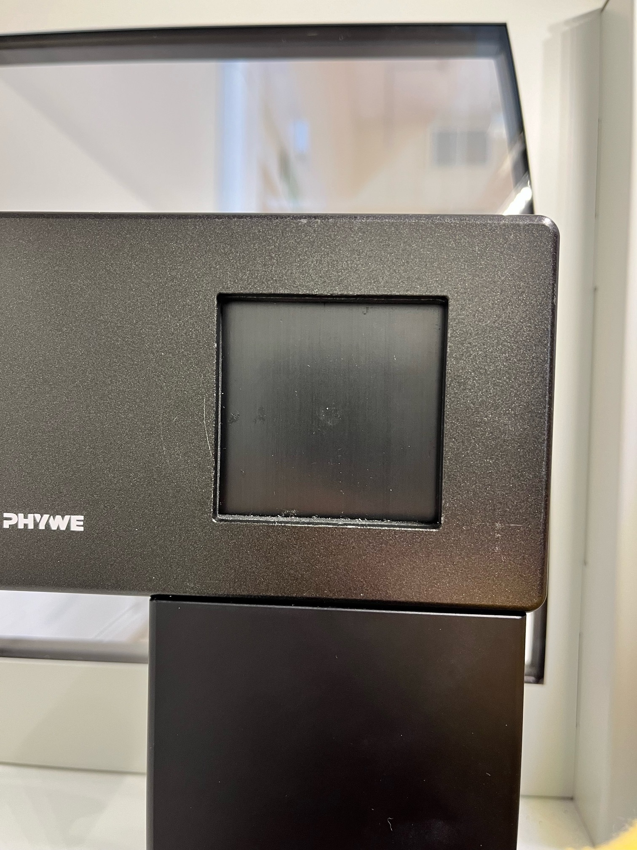
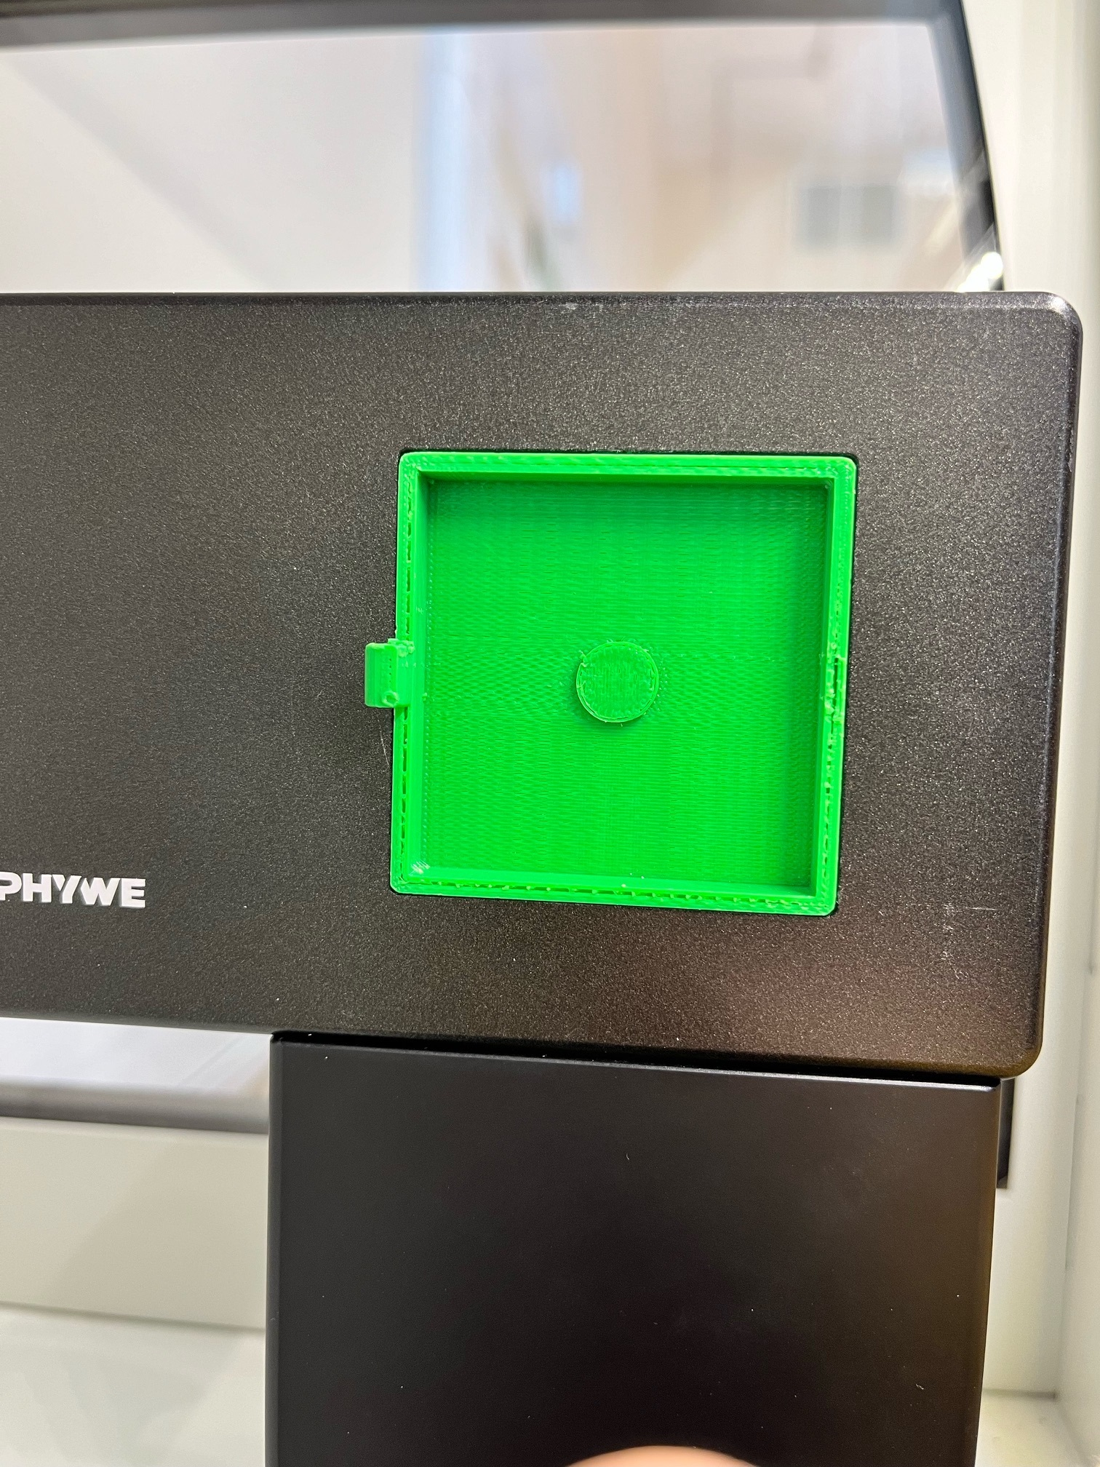
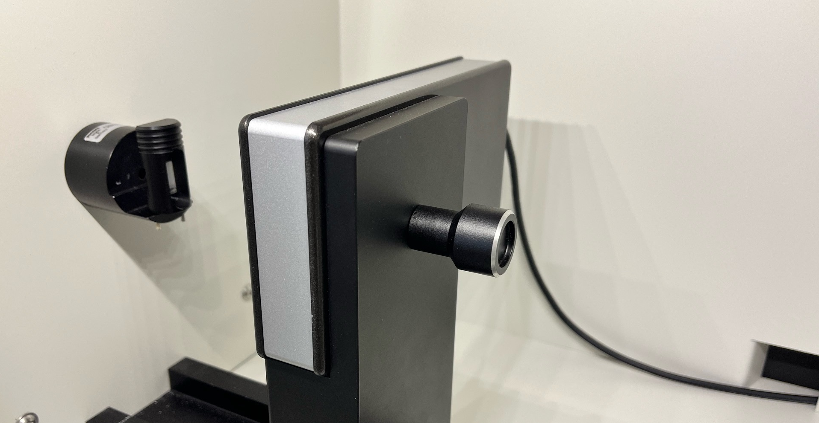
Experiment Setup
Beam Blocker
XRIS
1mm Aperture
Beam Blocker
Detector
X-rays
Detector
Crystal
XRIS
Notes:
Some of the X-rays will be reflected off the planes in the crystal, however most of them will pass straight through. These X-rays, if detected, would cause a bright spot in the centre of the image taken and make it more difficult to see the diffraction pattern. So, a ‘beam blocker’ is placed between the crystal and the detector, which absorbs all the incoming X-rays from the direct beam of light.

Slide 6
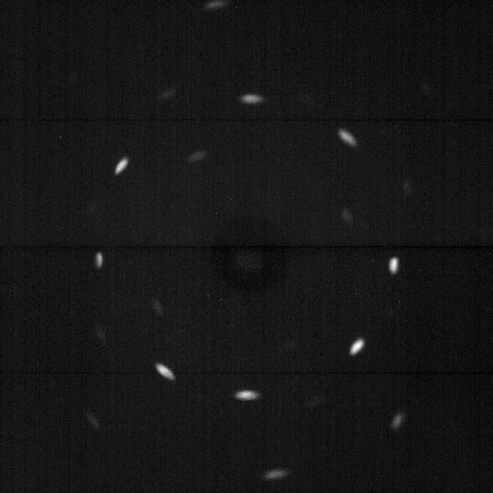
Method
Take an offset image
Take an image with X-rays
Subtract offset image and adjust contrast
Image quality depends on distance between the detector and the crystal, as well as the exposure time for each image.
Laue image taken without the beam blocker or use of an offset image
LiF 9cm 10s, Laue image, before adjusting contrast
LiF 9cm 10s, offset image
LiF 9cm 10s, Laue image, after adjusting contrast

Slide 7
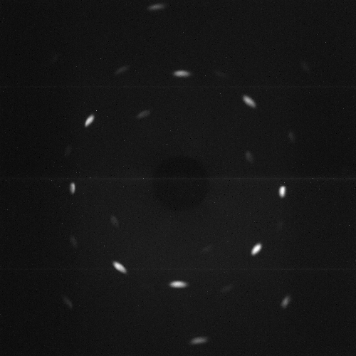
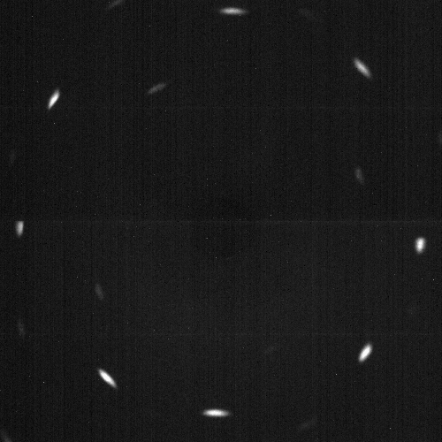
Method
Changing the distance between the detector and crystal changes the size of the diffraction pattern observed
Changing the exposure time for each image makes the picture clearer
LiF 9cm 10s, adjusted image
LiF 9cm 45s, adjusted image
LiF 10cm 10s, adjusted image
Notes:
Some of the X-rays will be reflected off the planes in the crystal, however most of them will pass straight through. These X-rays, if detected, would cause a bright spot in the centre of the image taken and make it more difficult to see the diffraction pattern. So, a ‘beam blocker’ is placed between the crystal and the detector, which absorbs all the incoming X-rays from the direct beam of light.

Slide 8
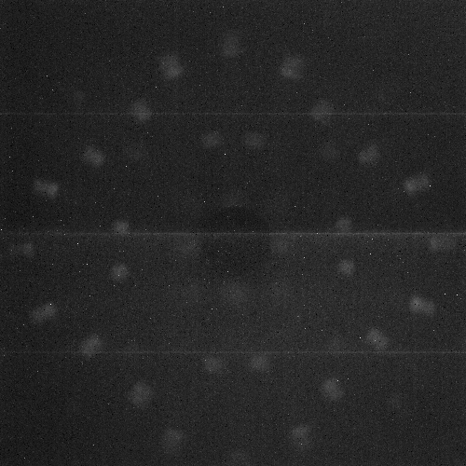
Results
Obtained two images showing the diffraction pattern when shining X-rays through two different crystals.
LiF 9cm 45s, adjusted image
NaCl 10cm 45s, adjusted image
Notes:
Some of the X-rays will be reflected off the planes in the crystal, however most of them will pass straight through. These X-rays, if detected, would cause a bright spot in the centre of the image taken and make it more difficult to see the diffraction pattern. So, a ‘beam blocker’ is placed between the crystal and the detector, which absorbs all the incoming X-rays from the direct beam of light.

Slide 9
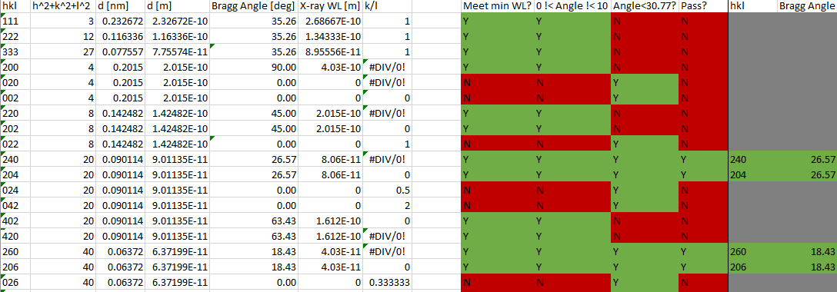

Data Analysis
List all possible combinations of Miller indices applicable.
Calculate the Bragg angle and X-ray wavelength required for each Miller index.
Remove Miller indices that don’t match the experimental setup.
Each image displays fourfold symmetry.
Measure the distance from the center of the image to each bright spot.
Find the scattering angle for each bright spot.
Compare theoretical and observed Bragg angles to identify the Miller indices of the bright spots
y
z
L
171.74
147.09
146.51
D
θ
θ = arctan$\left(\frac{L}{D}\right)$
Notes:
A list of 54 different
Each image displays fourfold symmetry; only need to analyse ¼ of each image.

Slide 10
Labelled Photos
y
z
z
-
224
244
-
y
-
226
244
226
206
-
260
-
113
206
- -
133
260
133
- -
113
-
226
- -
244
-
- -
133
133
-
244
226
244
-
226
133
-
133
226
-
- -
-
244
133
260
-
113
206
-
- -
- -
-
133
226
244
260
-
113
206
- -
224
-
226
-
244
LiF 9cm 45s, labelled image
NaCl 10cm 45s, labelled image
Notes:
Some of the X-rays will be reflected off the planes in the crystal, however most of them will pass straight through. These X-rays, if detected, would cause a bright spot in the centre of the image taken and make it more difficult to see the diffraction pattern. So, a ‘beam blocker’ is placed between the crystal and the detector, which absorbs all the incoming X-rays from the direct beam of light.

Slide 11
Discussion
Images taken show X-ray diffraction pattern as expected.
Theoretical Bragg angles were within error bars of the calculates ones.
Majority of the bright spots on each image were identified and associated with a plane.
LiF 9cm 45s, adjusted image

Slide 12
Conclusion
Images were of a good quality.
Characteristics of the image were as expected.
Most of the bright diffraction spots were identified.
Theoretical and observed Bragg angles agree.

Slide 13
Any Questions?

